Slide 1
Wilma and Sandy:
Tales of Public Servants Making It Work
Presenter: John J. Carroll, Ph.D.
Collaborative Emergency Management:
A Local Perspective
ASPA 2014 Annual Conference Washington, D.C.

Slide 2
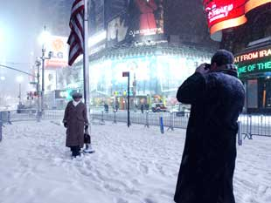
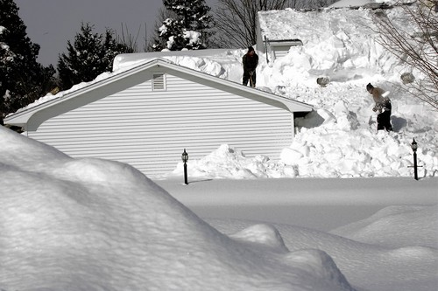
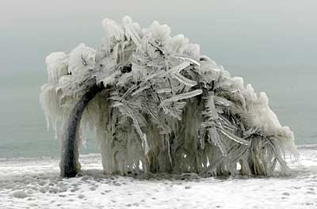
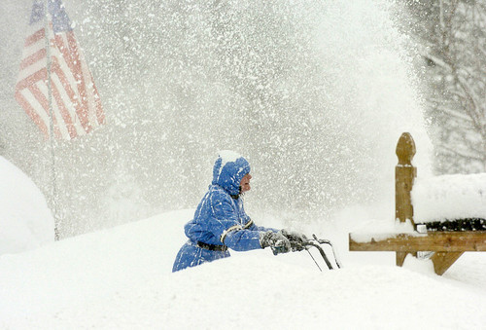
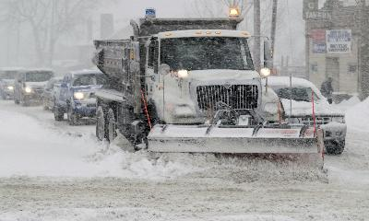
Wilma & Sandy: Tales of Public Servants Making It Work
ASPA 2014 Annual Conference Washington, D.C.
Why I live in South Florida…
Notes:
Side by side comparison of Hurricanes Floyd & Andrew

Slide 3
Wilma & Sandy: Tales of Public Servants Making It Work
ASPA 2014 Annual Conference Washington, D.C.
Part I:
Hurricane Wilma
October 2005

Slide 4
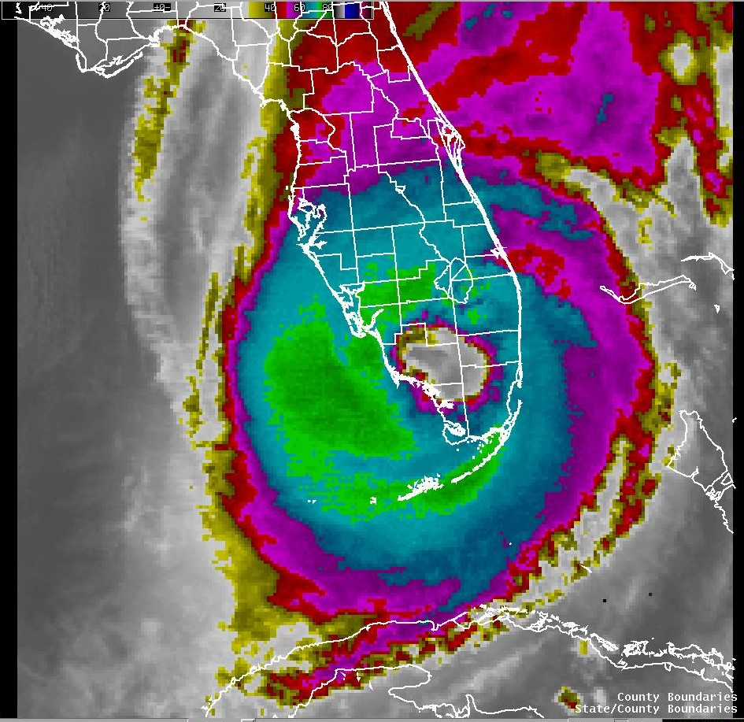
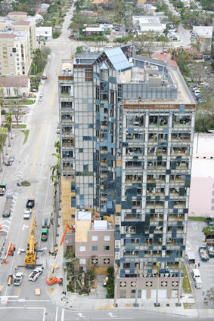
Wilma & Sandy: Tales of Public Servants Making It Work
ASPA 2014 Annual Conference Washington, D.C.

Slide 5
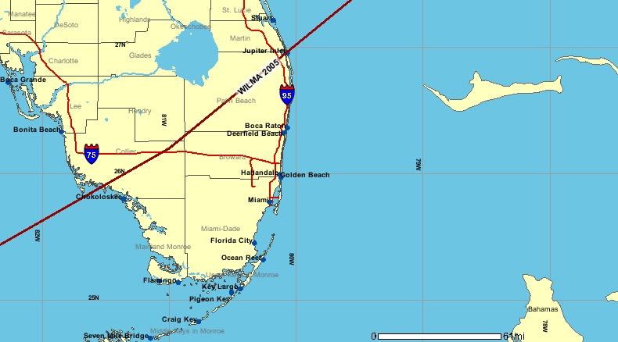
Hurricane Wilma In Perspective
Wilma & Sandy: Tales of Public Servants Making It Work
ASPA 2014 Annual Conference Washington, D.C.
Lowest pressure ever recorded
Landfall at Category 3/120 mph
Hurricane winds 90 miles from center
Forward speed 23 mph
Eye 45 mile wide
4 – 6 inches of rain
6 hours in duration
No storm surge

Slide 6
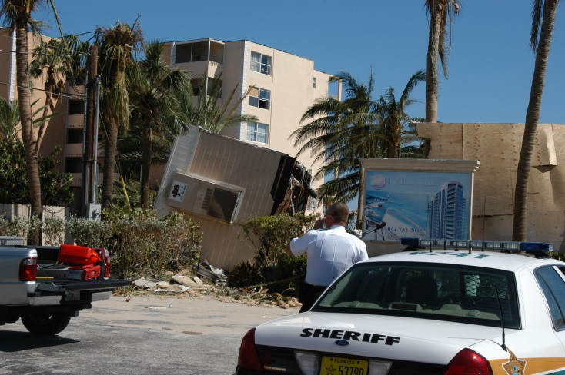
Hurricane Wilma In Perspective
Wilma & Sandy: Tales of Public Servants Making It Work
ASPA 2014 Annual Conference Washington, D.C.
Later became nor’easter, dumping 20” snow from
W. Virginia to New England
Strongest storm to strike Fort Lauderdale since 1950
$29 billion in damage (4th most)
6 million people without power
Water & Sewer out of service
No traffic control

Slide 7
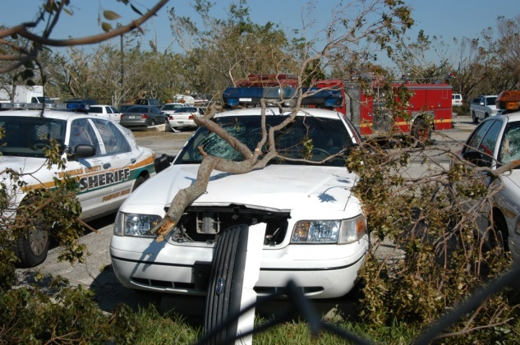
Wilma & Sandy: Tales of Public Servants Making It Work
ASPA 2014 Annual Conference Washington, D.C.
Broward Sheriff’s Office
More than 5,800 employees
Patrol 1/3 of the Broward population of 1.8 million
Dispatch for ½ of the Broward population
Contract services to City, County, State, & Federal Governments

Slide 8
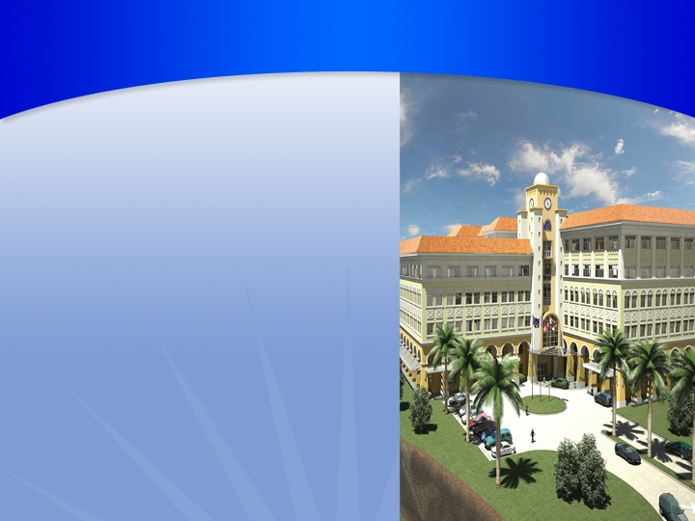
The value of NSU research grants has tripled over the past six years
Wilma & Sandy: Tales of Public Servants Making It Work
ASPA 2014 Annual Conference Washington, D.C.
Part II:
Hurricane/
Post-Tropical
Cyclone/
“Super-storm”
Sandy
October 2012
More than 150 outside-funded research projects, valued at $45 million, are now underway
NSU’s board of trustees supports research with seed-money grants
Home to the USGS and the $8.5 billion Everglades Restoration
Acquired the Rumbaugh Goodwin Institute for Cancer Research in 2005
Center for Collaborative Research building to open in 2009

Slide 9
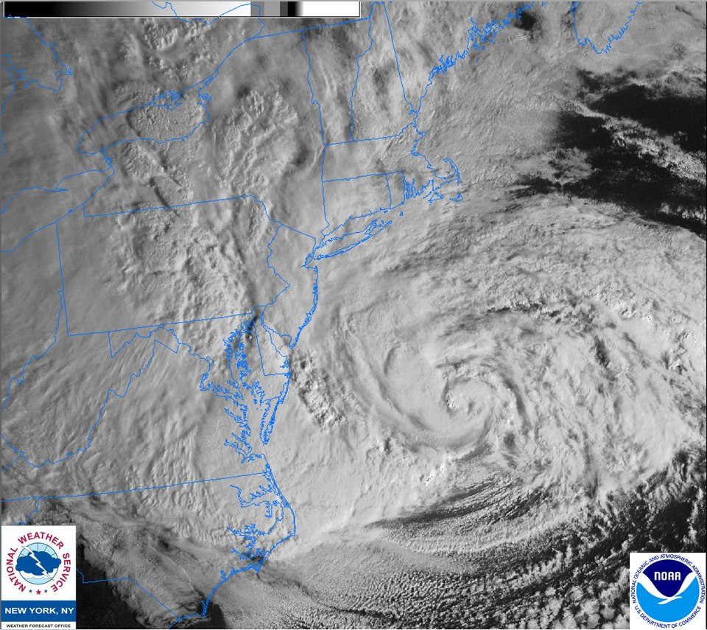
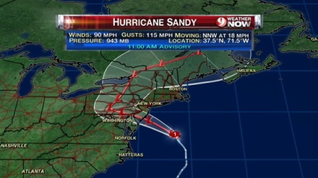
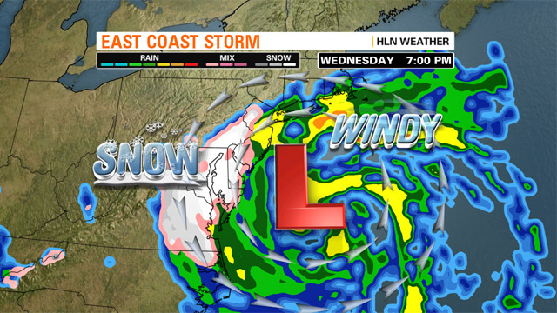
Wilma & Sandy: Tales of Public Servants Making It Work
ASPA 2014 Annual Conference Washington, D.C.

Slide 10
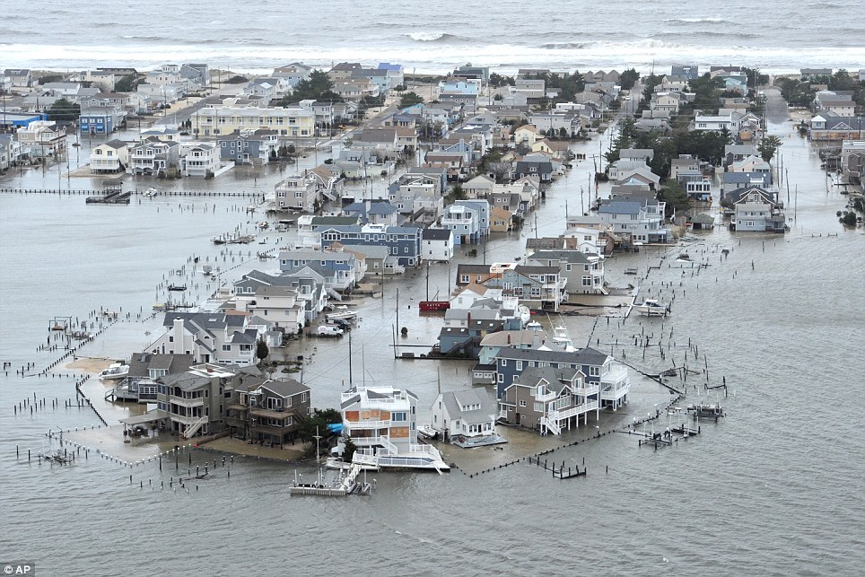
Wilma & Sandy: Tales of Public Servants Making It Work
ASPA 2014 Annual Conference Washington, D.C.
Sandy in Perspective
1,000 miles across
66.5M people in path
18 states affected
24” snow in W. Va.
80 MPH max gust (<Cat 1)

Slide 11
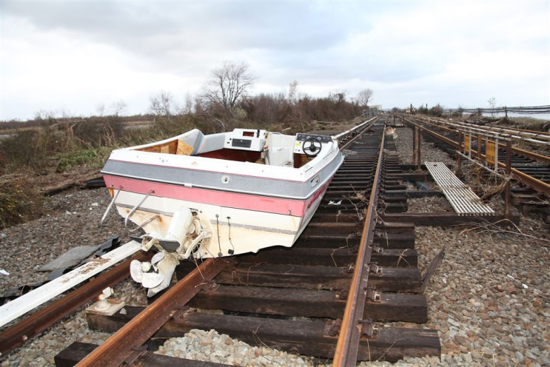
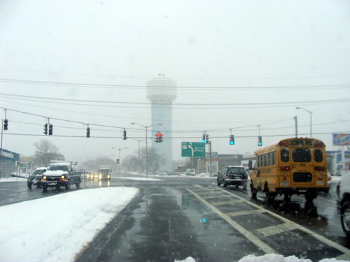
Wilma & Sandy: Tales of Public Servants Making It Work
ASPA 2014 Annual Conference Washington, D.C.
Sandy in Perspective
8M people without power
55 deaths, scores injured
10.8’ storm surge in E.R.
$68B recovery (2nd highest)
Then, it snowed (Nov 7-8)

Slide 12
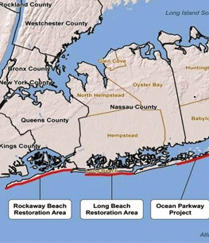
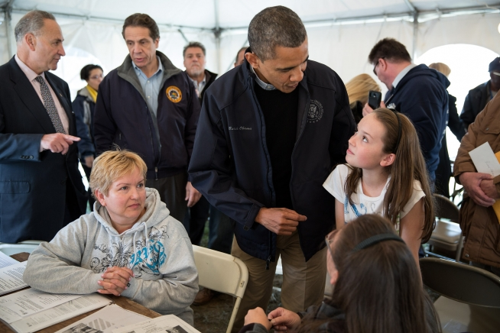
Wilma & Sandy: Tales of Public Servants Making It Work
ASPA 2014 Annual Conference Washington, D.C.
Sandy in Focus
Town of Hempstead
Village of East Rockaway
E.R. Public Schools
Bay Park (unincorp.)
Why & Interviews

Slide 13
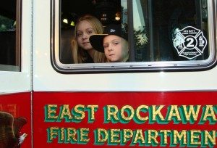
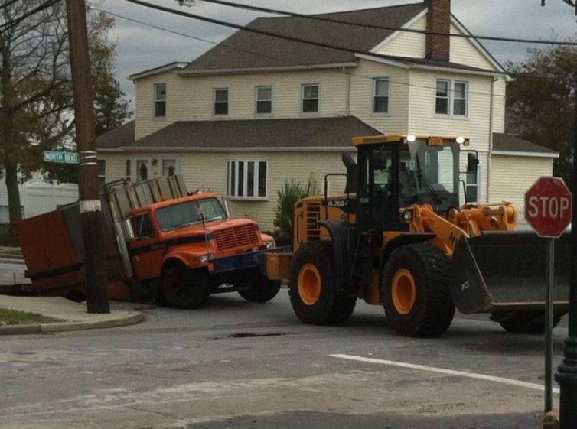
Wilma & Sandy: Tales of Public Servants Making It Work
ASPA 2014 Annual Conference Washington, D.C.
Sandy in Focus
Storm surge inundates Bay Park & Village
E.R. High School closed 6 months
Rhame Av. Elementary closed 5 weeks
Homes uninhabitable, businesses closed

Slide 14
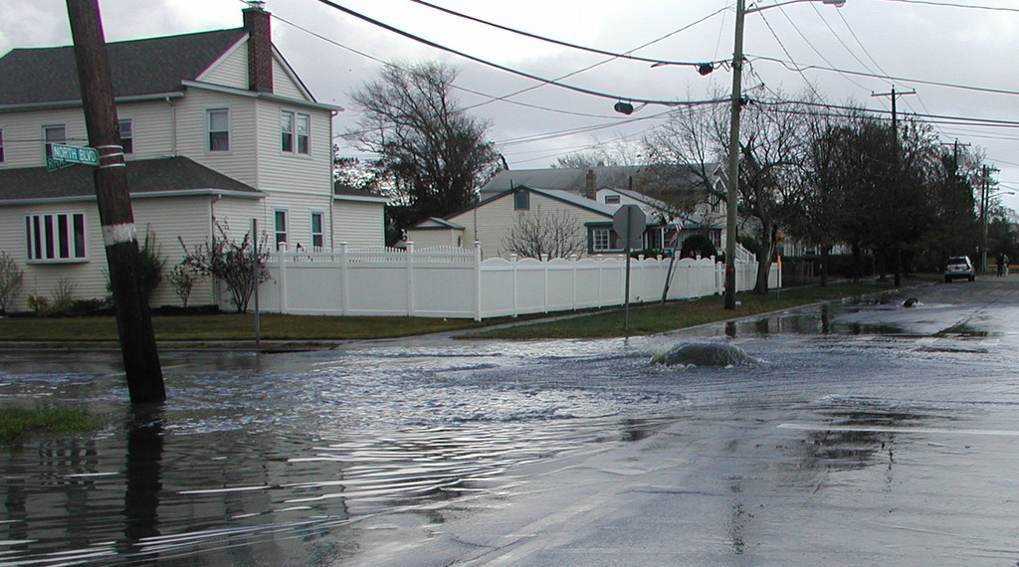
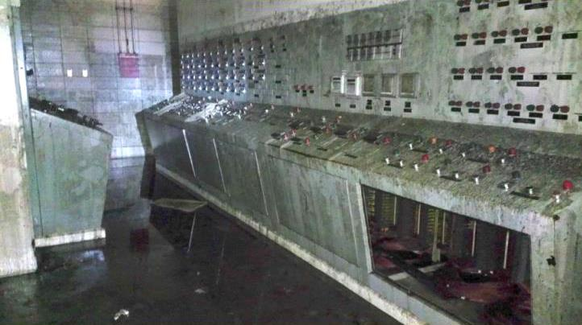
Wilma & Sandy: Tales of Public Servants Making It Work
ASPA 2014 Annual Conference Washington, D.C.
Bay Park Treatment Plant
44 hours completely out of service
100M gallons untreated sewage
44 days to fully restore service
2.2B gallons partially treated sewage

Slide 15
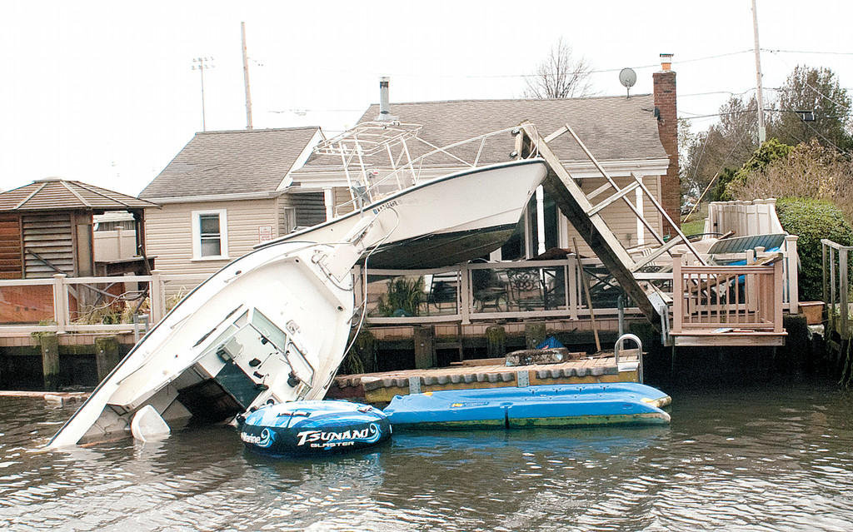
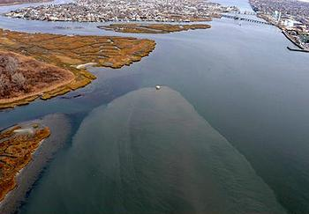
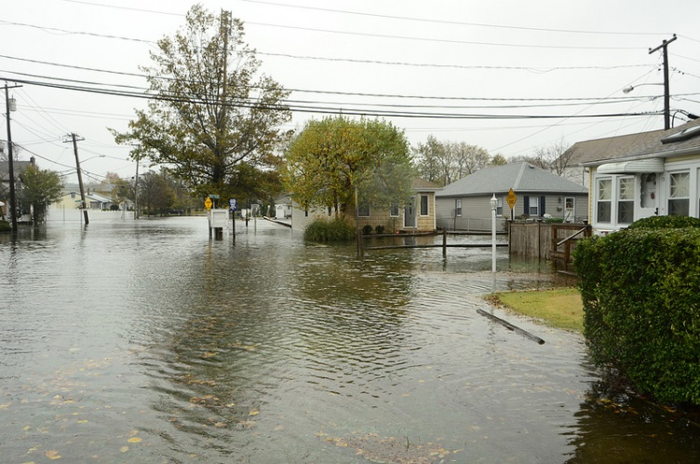
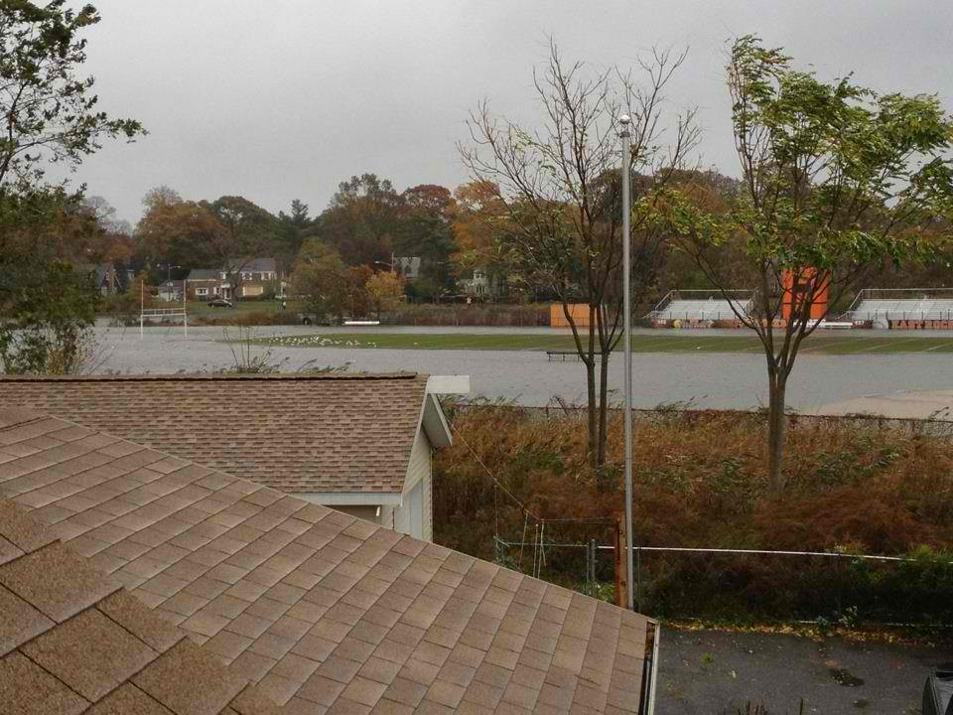
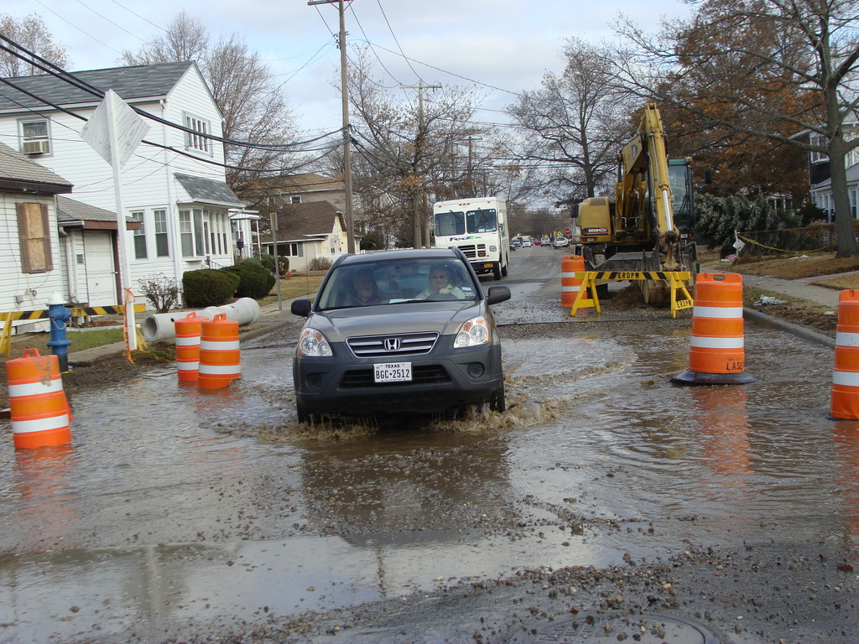
Wilma & Sandy: Tales of Public Servants Making It Work
ASPA 2014 Annual Conference Washington, D.C.

Slide 16
Wilma & Sandy: Tales of Public Servants Making It Work
ASPA 2014 Annual Conference Washington, D.C.
Part III:
Collaborative
Emergency Management…
Making It Work

Slide 17
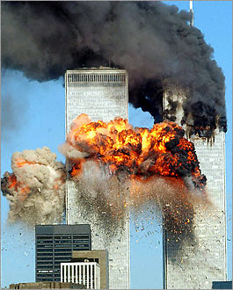
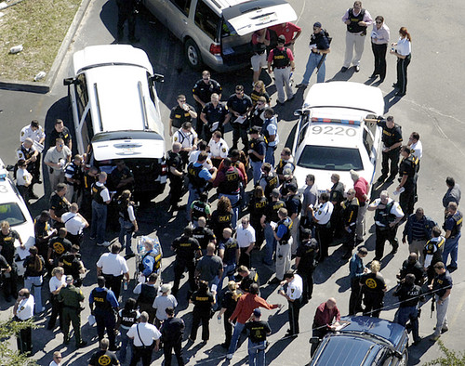
Wilma & Sandy: Tales of Public Servants Making It Work
ASPA 2014 Annual Conference Washington, D.C.
BSO 9/11 Lessons 2002-2003
Interoperability and Communications
Data sharing and data systems
Terrorism preparedness
Clarity in chain of command
Disaster response plan
Airport & Seaport

Slide 18
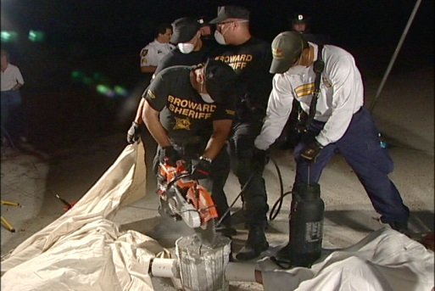
Wilma & Sandy: Tales of Public Servants Making It Work
ASPA 2014 Annual Conference Washington, D.C.
BSO Building Team Experience 2004-2005
RDSTF
2004 hurricane relief X 3: Deployment of Field/Strike Forces
Joint Field Force Training/Fire Rescue Technical Rescue Teams
OAS General Assembly June 2005
2005 busy hurricane season

Slide 19
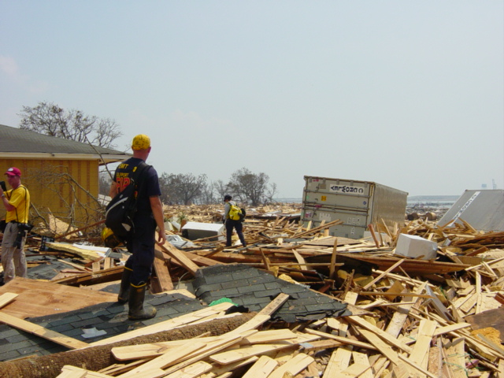
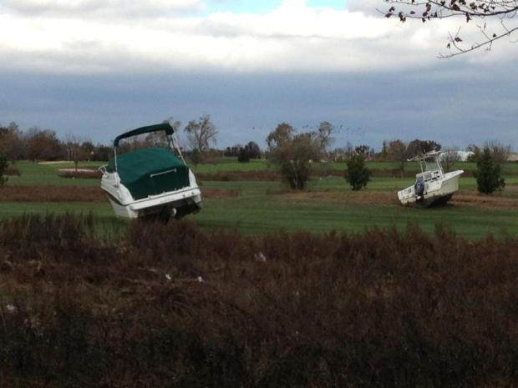
Wilma & Sandy: Tales of Public Servants Making It Work
ASPA 2014 Annual Conference Washington, D.C.
Wilma & Sandy
Assessing Property Damage
Coordination/Barriers & Egos Set Aside
Value of Teambuilding & Experience
Loss of Utilities & Fuel
Communications

Slide 20
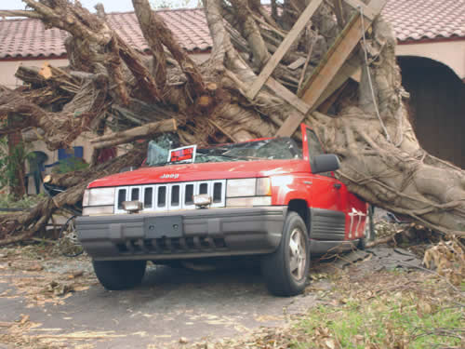
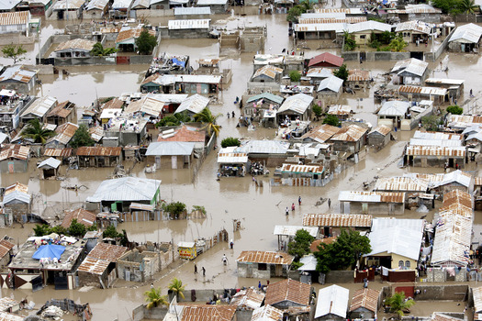
Wilma & Sandy: Tales of Public Servants Making It Work
ASPA 2014 Annual Conference Washington, D.C.
Wilma & Sandy
High visibility of elected officials
Crisis as test of leadership
Managing Volunteers & Supplies
Employees as Victims
Elections
COOP

Slide 21
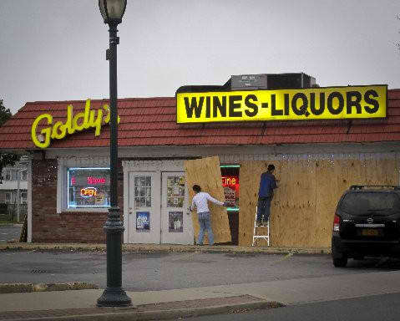
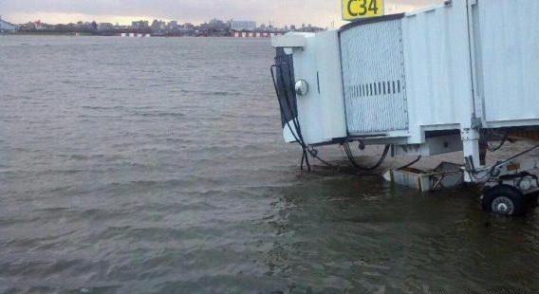
Wilma & Sandy: Tales of Public Servants Making It Work
ASPA 2014 Annual Conference Washington, D.C.
Sandy & East Rockaway
Much more satisfied with their response
Irene (2011) did not prepare them
School as a sense of “home”
Celebrate small victories
Emotional Time/Healing
All felt lucky to serve

Slide 22
Wilma & Sandy: Tales of Public Servants Making It Work
ASPA 2014 Annual Conference Washington, D.C.
Sandy & East Rockaway
Unconditional Love
Unquestioned reciprocal trust
Courage, dedication, & selflessness beyond devotion to duty
Refusal to take “no” for an answer
Addition of “feminine” element
Sandy Hook, CT/Moore, OK

Slide 23
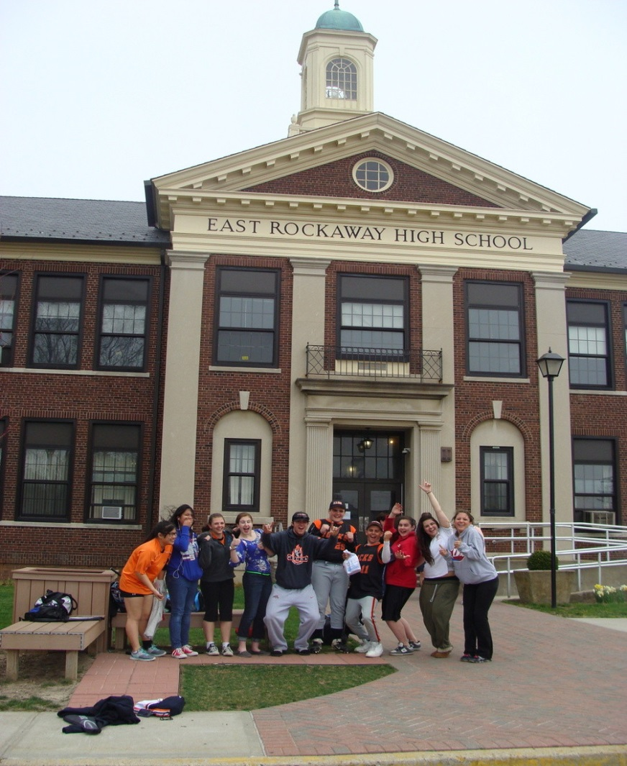
Wilma & Sandy: Tales of Public Servants Making It Work
ASPA 2014 Annual Conference Washington, D.C.
Learning Across Time,
Borders, & Culture
Teamwork/Experience
Leadership
Resiliency
Intergovernmental coordination
Commitment to Success
Communications
Unconditional Love

Slide 24
Wilma and Sandy:
Tales of Public Servants Making It Work
Thank you for your participation!
Collaborative Emergency Management:
A Local Perspective
ASPA 2014 Annual Conference Washington, D.C.

